Slide 1
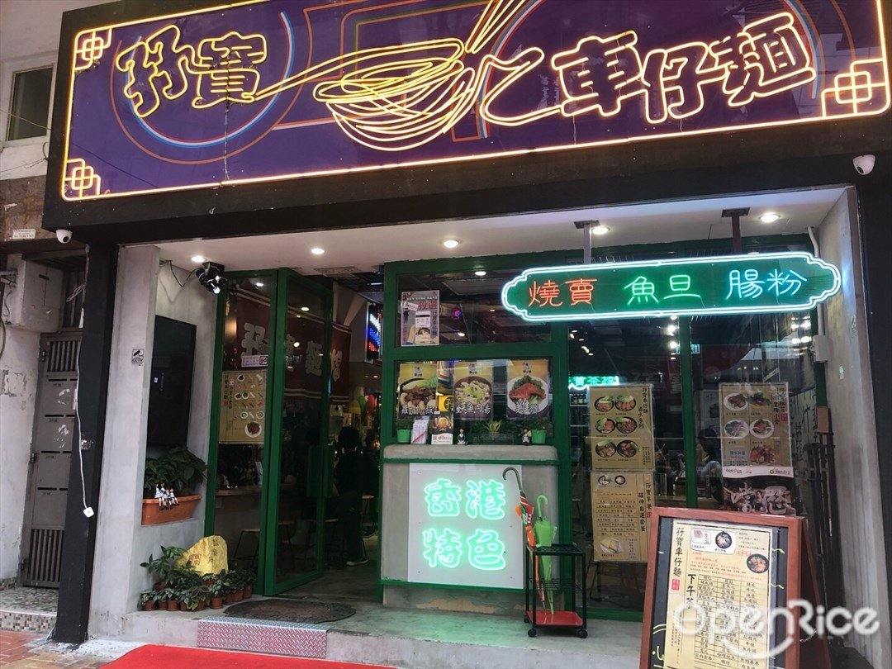

孖寶車仔麵 (荃灣大壩街/葵涌廣場) Marble Cart Noodles Online Food Ordering and Delivery Services
https://youtu.be/ptgciAlOfyA
SEHH3143
Group ID
201A-G04
Students ID and Name
19069390A NG Ka Wah
19071963A CHEUNG Chung Yin
19076020A NG Long Hin
19132788A TSANG Kit Hong Andrew
19087635A WAN Sheung Yam

Slide 2
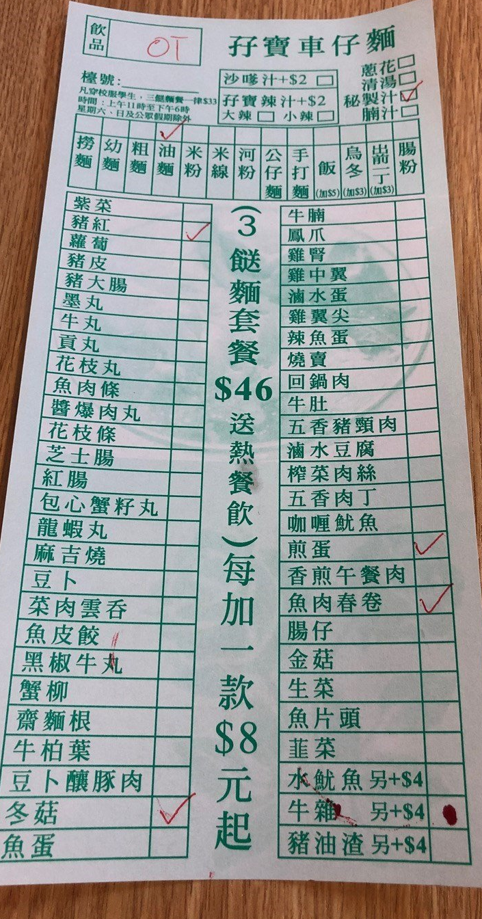
The current problems or limitation
The order may get wrong
The food is not what the customers ordered, or the delivery address is not correct.
Unable to server more than one customer
There is only a customer can order the food by phone calling at the same time.
Paying cash is the one and only way
The customers can only pay the cash to the deliveryman.
It is inconvenient to change the menu
It is hard to design the menu which is clear and easy to read when there are a wide range of items and price. It is also hard for the customer to read the menu without sorting.
The customer may not choose the nearest restaurant.
The customer may not order the food form the nearest restaurant; it makes the deliveryman need to spend more time to deliver the food.

Slide 3
Objectives of the proposed system
For the existing system, apparently there are some omissions that are not suitable for Hong Kong, those would lead to customers and employee dissatisfaction.
Our requirement is going to solve the currently problems by reuse approach. The currently functions of the application are aim to combine both customer, vender and deliveryman in one structure, performing a complete takeaway system.
In overall business requirements, reduce the operating time and promote the turnover are the objectives that we must achieve.
In the system, by providing the simplicity progress for the users, that can reduce the operating time. Besides, there are analyzation in the application, it assists the restaurant to determine the future strategies and objectives.

Slide 4
Non-functional requirements
Product requirements
Organizational requirements
Speed | -The system user/event response time in 0.5 seconds. -Process time: 1 seconds
Ease of use | -Staff training time 2 days. -User can order in 5 steps. -New user order in 7 steps.
Reliability | Mean time to failure three month.
Probability of unavailability | <3%
Robustness | Time to restart after failure 1 hours.
Portability | Design for android and apple devices.
The system has set a require time for user from order to delivery. The duration of progress around 20-40 minutes.
The first order time is 11:30 and last order time is 20:30. (Restaurant opening hours : 11:00-21:00)
The minimum consumption is at least $40.
The maximum order is 15 items each time.
The maximum order the deliveryman can receive each time is 5.
The maximum delivery distance is 2.5km around the restaurant.
External requirement:
The system shall not disclose any personal information and credit card number of the customers apart from their name and reference number to the operators of the system.

Slide 5
Functional requirements of the proposed system
Customers
Chef
vendor
Deliveryman

Slide 6
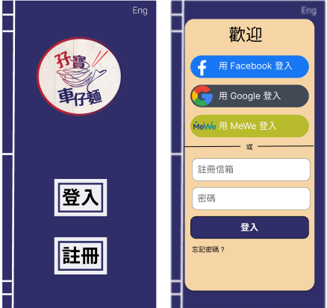
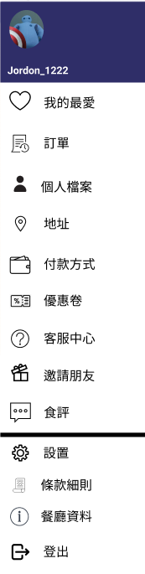
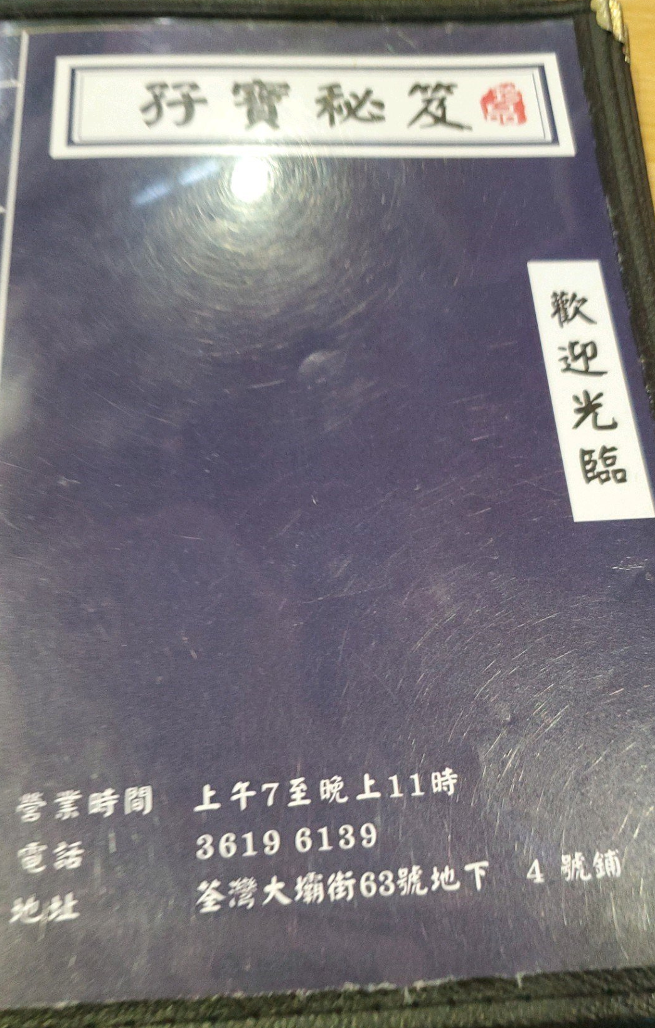

Functional requirement-Customers
Register/Forgetting passwords
choose Facebook/Google/MeWe
traditional way email address to register
Confirm email the link only effective in two weeks.
Multi-functional menu
In left top corner The user can choose the other function in system. Also, display the user icon.
Shopping cart
Right top corner is a shopping cart button
Check the price and the items they choose
Cart icon will show the number of items.

Slide 7
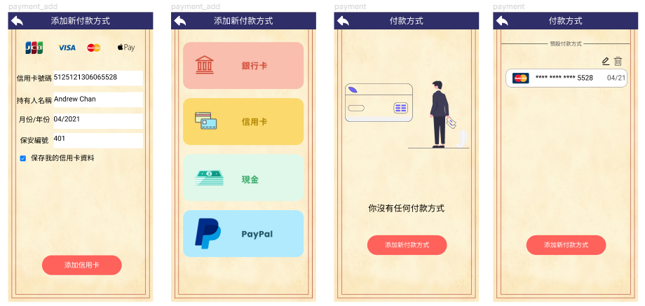
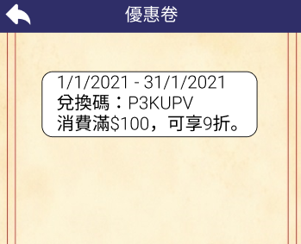
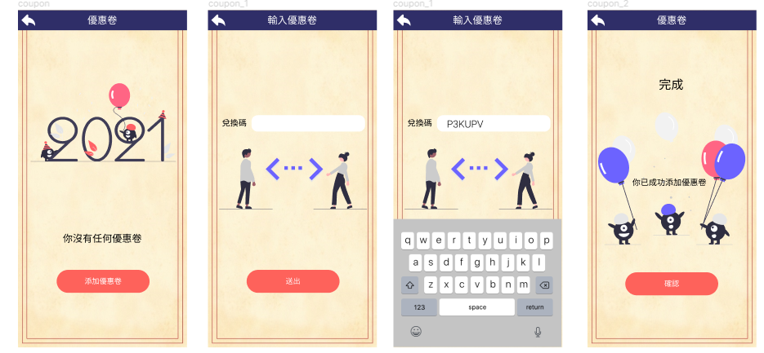
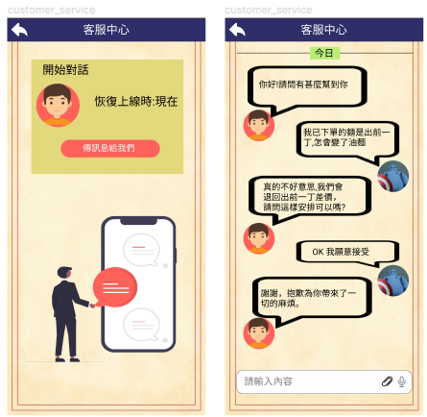
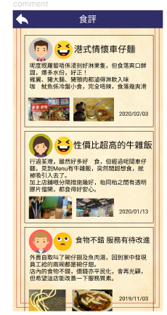
Functional requirement-Customers
Payment method
If the payment method is empty, it will display message that “You don’t have any payment method.” under the message will have a button to add new payment method then user can choose to add which payment method credit card or PayPal then input their payment method.
If it has payment method, it will display the payment method also the user can edit the payment method or delete or add more payment method.
Coupons
If the coupon is empty, it will display message that “You don’t have any coupons.” Under the message, there is a button to add a coupon. The user can input the code of the coupon and send it out. After the user send the code of the coupon. There will be a message show” you have added a coupon successfully." After adding a coupon, the home page of the coupons will show all the coupon user have and show the deadline, discount of the coupon.
Customer's service
User can text to shop in business hours. User can put forward what the problem is. The shop will respond to the customer. If the order is incorrect, shop will send an appropriate compensation to customer.
Reviews
User can view other user review of the food.

Slide 8
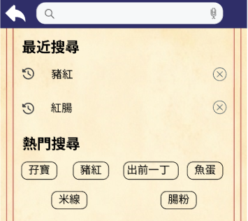
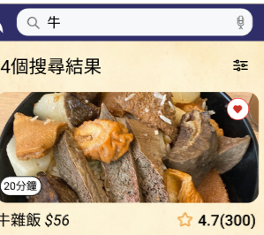
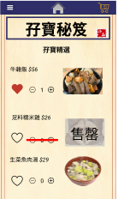
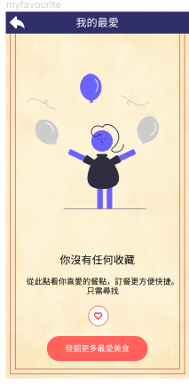
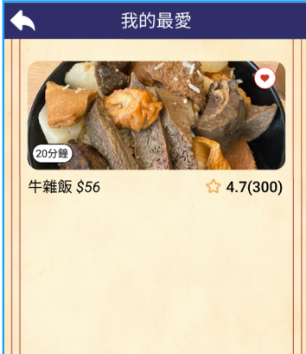
Functional requirement-Customers
Searching bar and Filter button
The user can type or use the voice function
record and cancel the records
hot searching words
filter button, user sorts by the price, rating and waiting time.
Menu
Display the menu supply and it can be changed id the food is valid or not.
Buying function
order or cancel the food
each of the item have a heart the items will add in my favorite page.
My favorite page
If the favorite is empty, it will display message that
“You don’t have any favorite.” under the message will a button to
show explore more once it pressed it will back to home page.
If it has favorite food, it will display the favorite food also with the price,
rating and the delivery time.

Slide 9
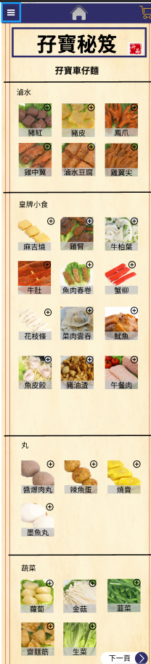
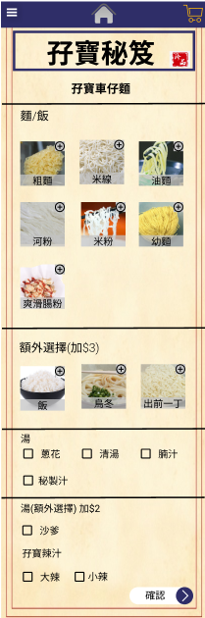
Functional requirement-Customers
Step 1
Cart Noodle
In first page's user can choose the toppings
the toppings is dividing into marinated food, snacks, balls, vegetables.
In the second pages, user can choose noodles, rice and rice roll.
In last section, user can choose the type of soup, such as satay or marble spicy sauce.
Step 2

Slide 10
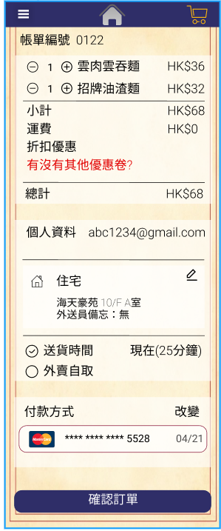
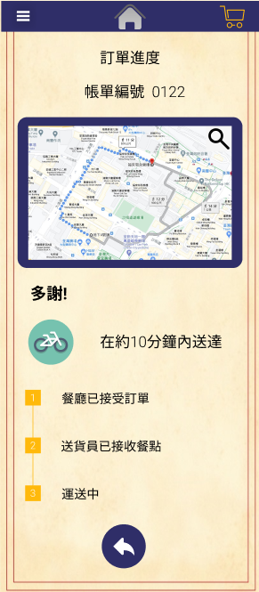
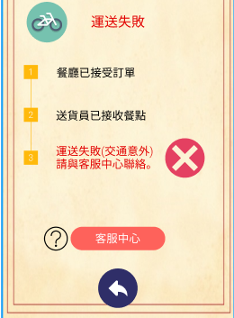
Functional requirement-Customers
Place order
After pressing the shopping cart, let user double the order from marble cart noodles the items, price and the address.
Pickup and delivery details
The user can choose the pickup time such as, the exact time or as soon as possible.
User can edit their address here.
Personal details
User can check their name, email and phone number again, deliveryman can call user if there is any delivery problem or find the way to deliver.
Payment
User can add or choose the credit or debit card or PayPal these payment methods.
There is an option that payment method records the user used last time.
Coupons
User can choose the coupons input before or input a new one when they before place order.
Track
User can track the delivery location and the estimate the time. Also, view the error case.

Slide 11
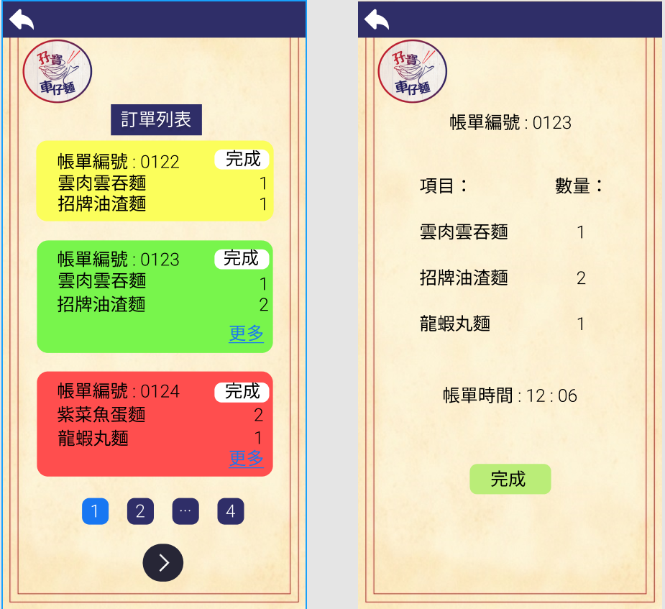
Functional requirement -Chief
Chief:
There is a page to list the orders.
Page selecting button
The app will show the page selecting button at the bottom, the vender can tap the arrow icon to go to the next page or select the pages directly.
Done button
There is the button in the top-right corner, the cook can tap the button to let the deliveryman know the food is ready.

Slide 12
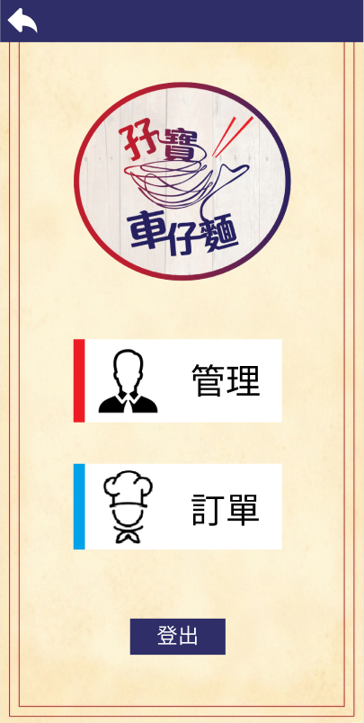
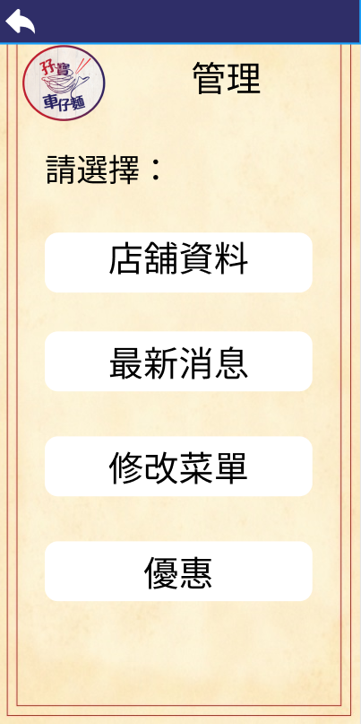
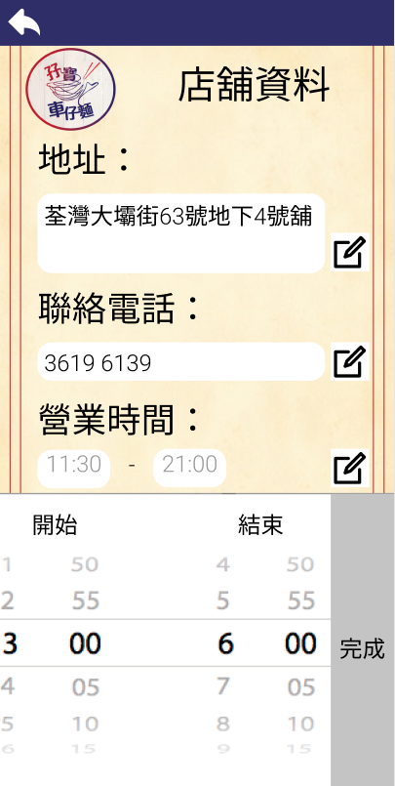
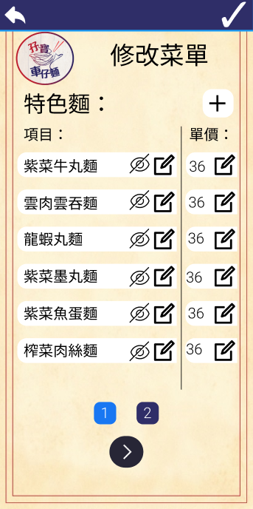
Functional requirement -Vender(Admin)
Main page
The vender can choose to check the information of the current orders and manage the information of the restaurant.
A) Management
Main page of the management
The venders can choose to edit the information about the restaurants, update the news, edit the menu and add the discount by tapping the buttons.
i) About the restaurant
The vender can edit the address, contact number and opening hours of the restaurants.
Editing buttons
There are the editing buttons near each item.o add text
Hidden button
There are the editing buttons near each item, the vender can press the button if the products are not available.
Editing the opening hours with time selector
For the opening hours, there is the time selector for the vender to change the opening hours easily.

Slide 13
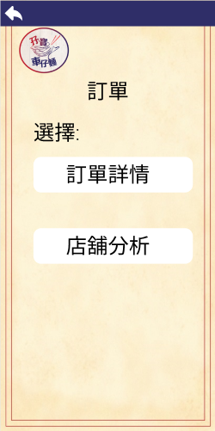
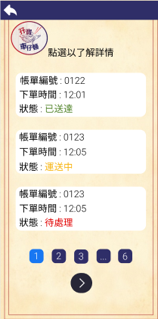
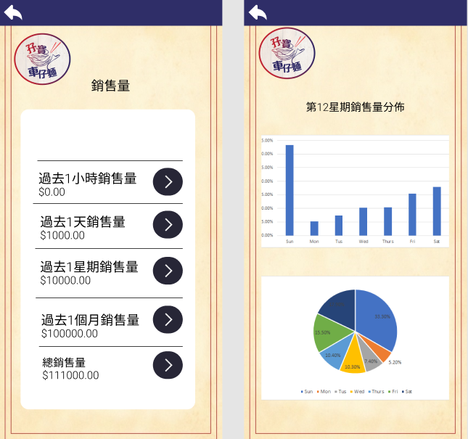
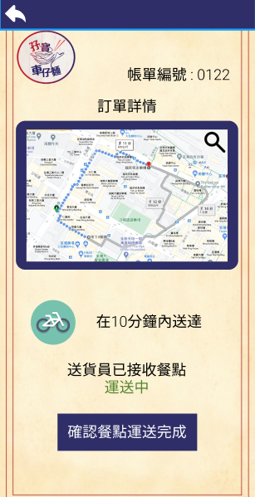
Functional requirement-Vender
A) Ordering
After clicking the ordering button in the main menu, it switches
to the order management page. The vendor can choose the analyzation or information of order
Information of order
Analyzation
Order block
The vendor can click the order block and go to the next page to watch the abstract information of the order.
Vendor can check the status of the order
Analyzation page
vendor can check the analyzation
I)Turnover
II)Popular food
III)Popular time period
IV)Popular payment methods

Slide 14
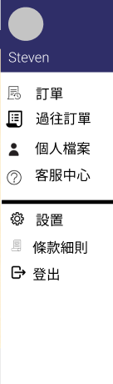
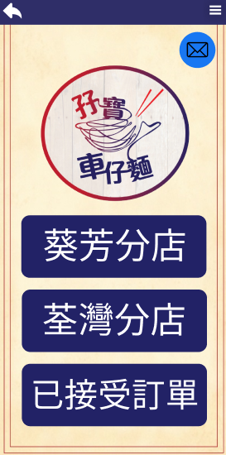
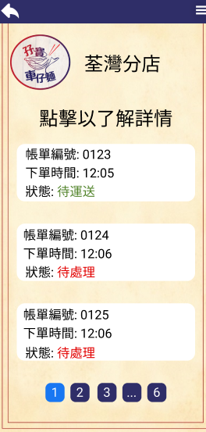
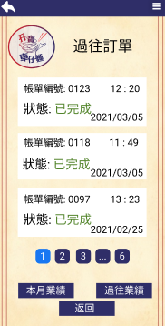
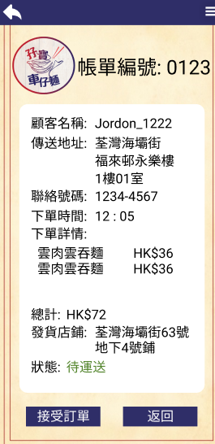
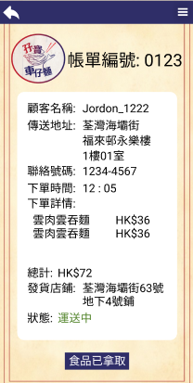
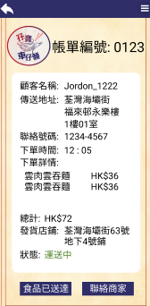
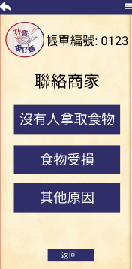
Functional requirement- delivery man
Main page
You can choose one restaurants to get the order
After you click one of the restaurants you can
choose orders and it will show you
Order ID
Order time
Order status
The order are ordering by ascending
order by the order time
Step 3.
Finish the order.
Step 1.
Accept the order
Step 2.
Take the order.
Others
Accident

Slide 15
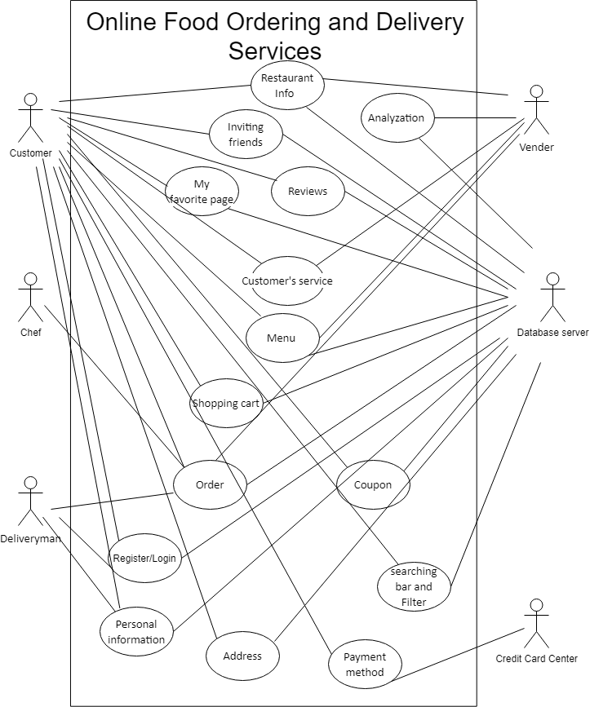
Design Model use case diagrams
Analyzation: The analyzation can analysis the revenue of that month and stored in a centralized database server.
Order: The orders are stored in a centralized database server which all the actor customers, deliveryman and vendor can see it.
Payment method: The credit card payments are paid by customers and confirmed by credit center which the data will not store in the database.

Slide 16
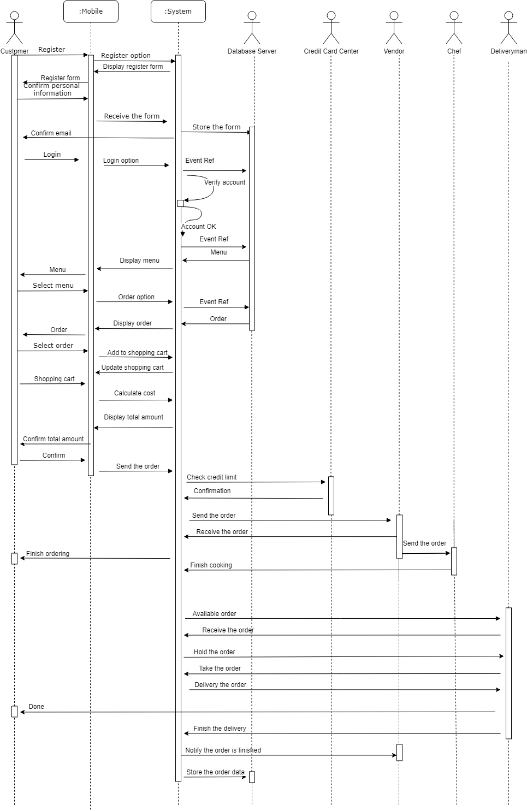
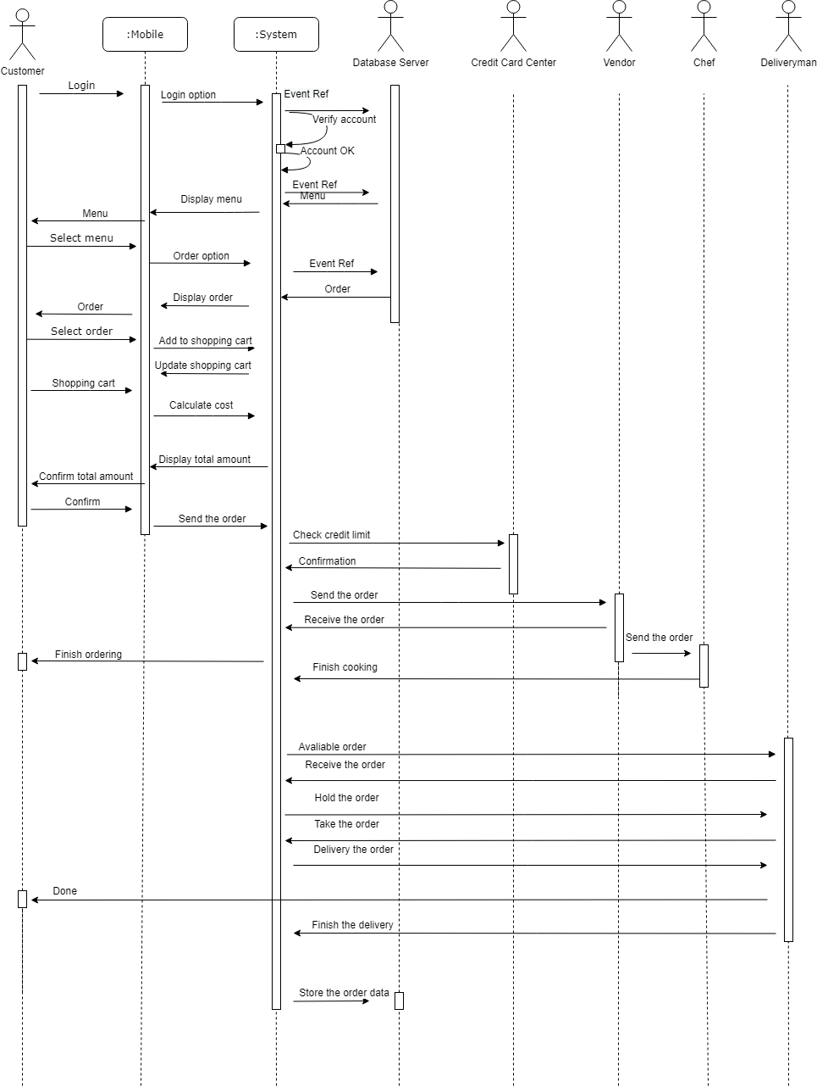
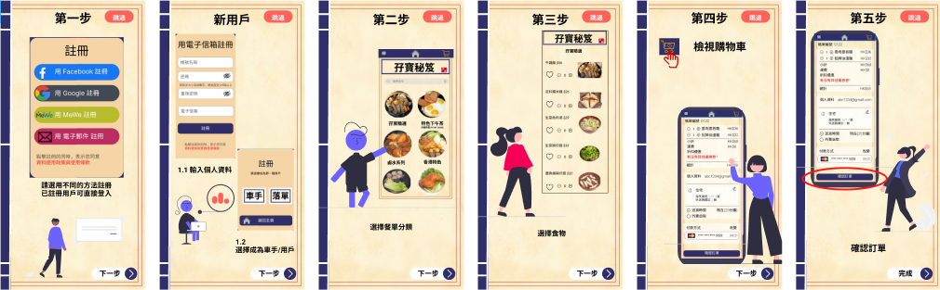
Design Model Sequence Diagrams-Normal scenario of ordering
(5 steps)
(New user order)
(7 steps)

Slide 17
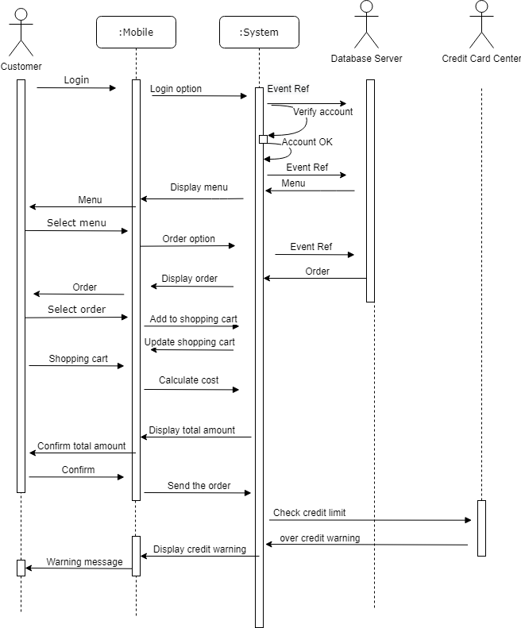
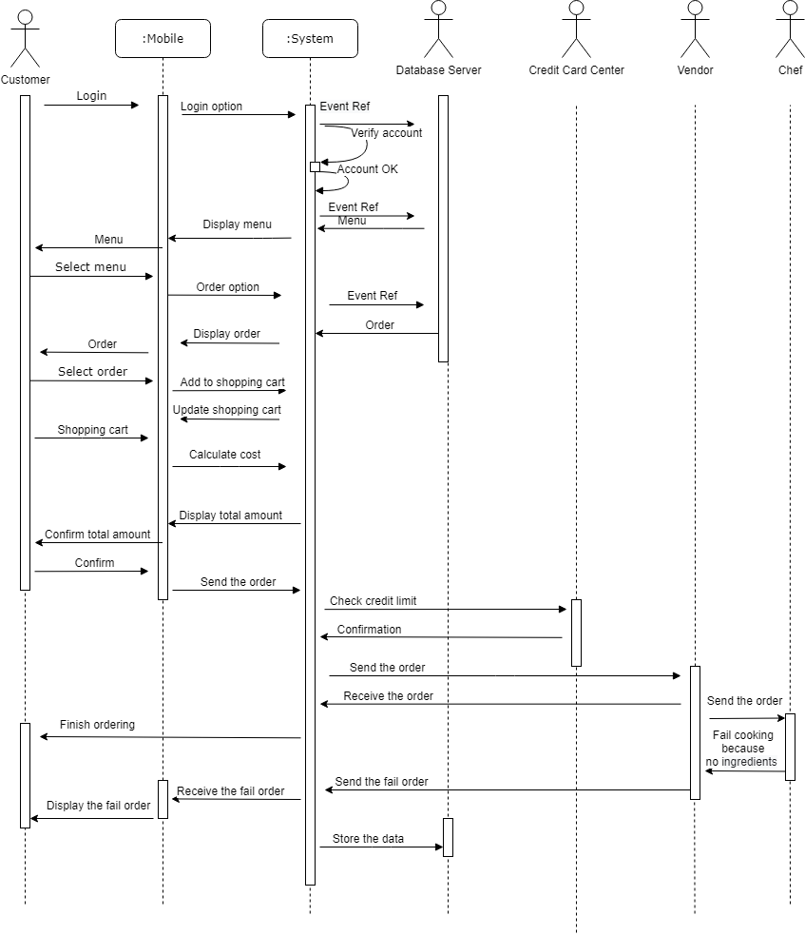
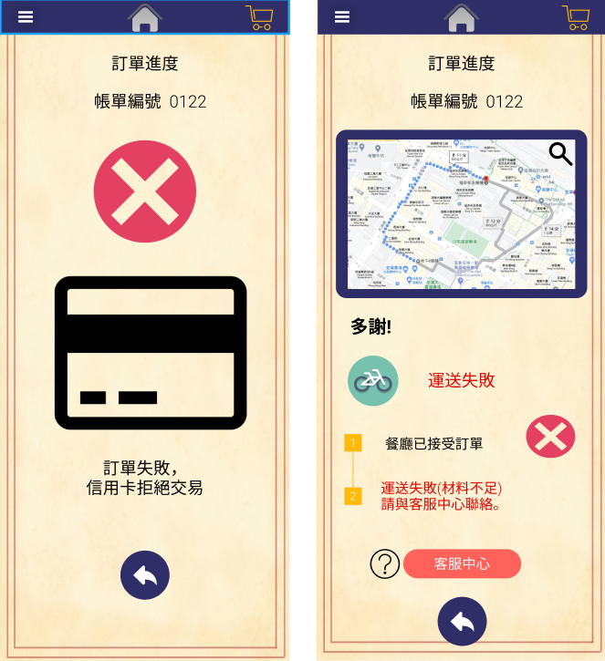
Design Model Sequence Diagrams-Exceptional scenario of ordering
credit limit
no ingredient

Slide 18
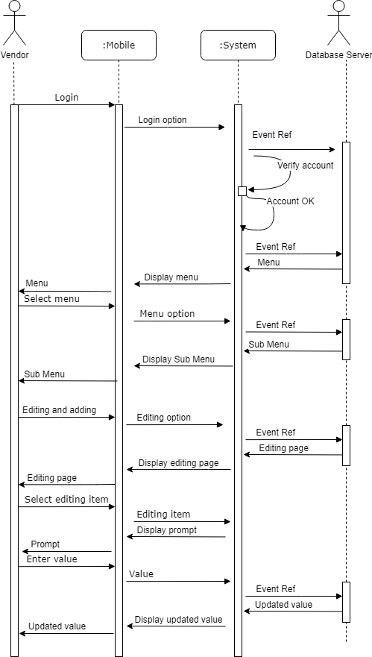
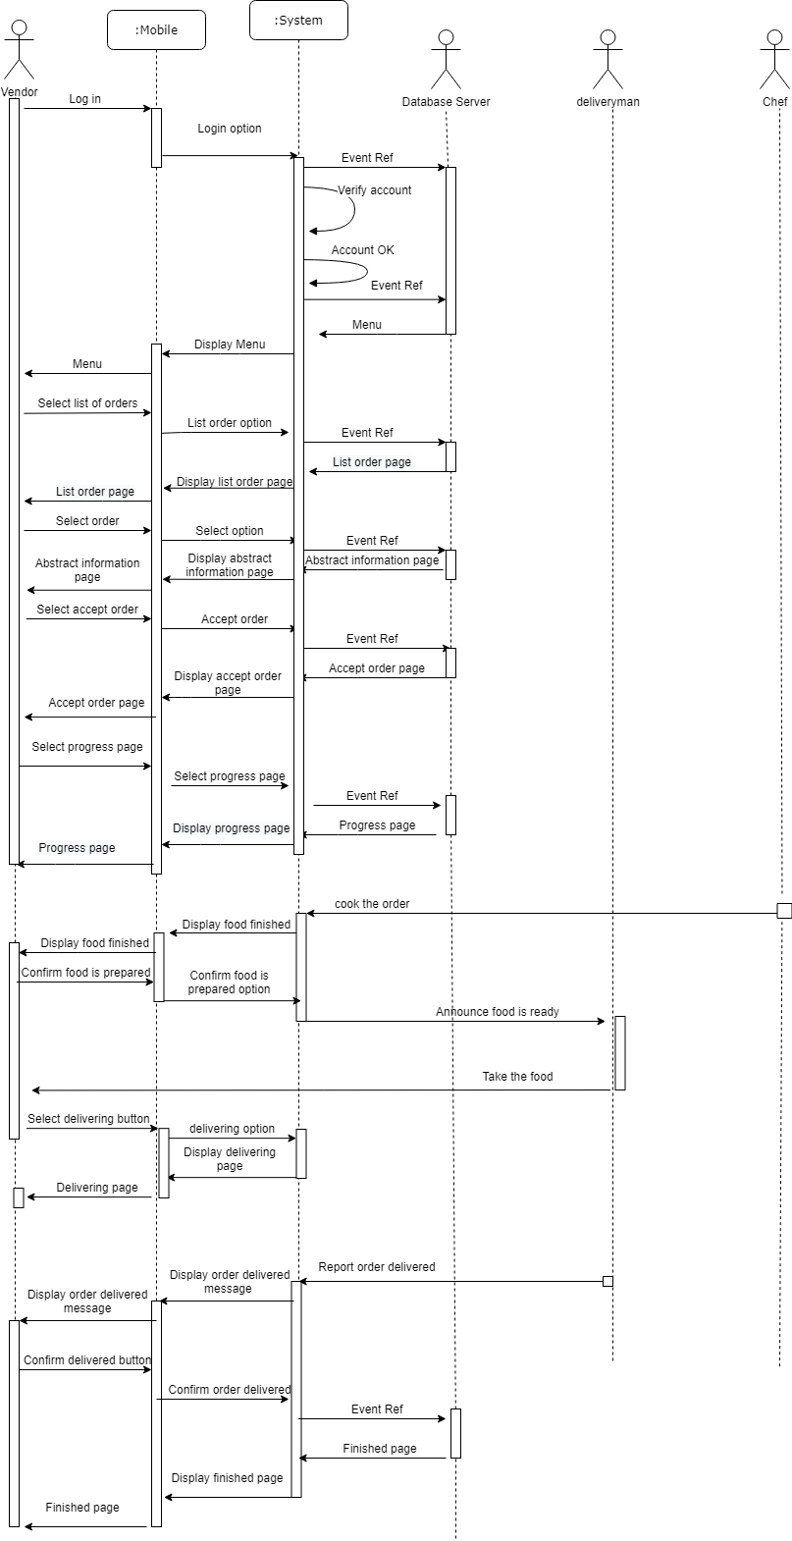
Design Model Sequence Diagrams-Normal scenario of accept order
Accept order
Management

Slide 19
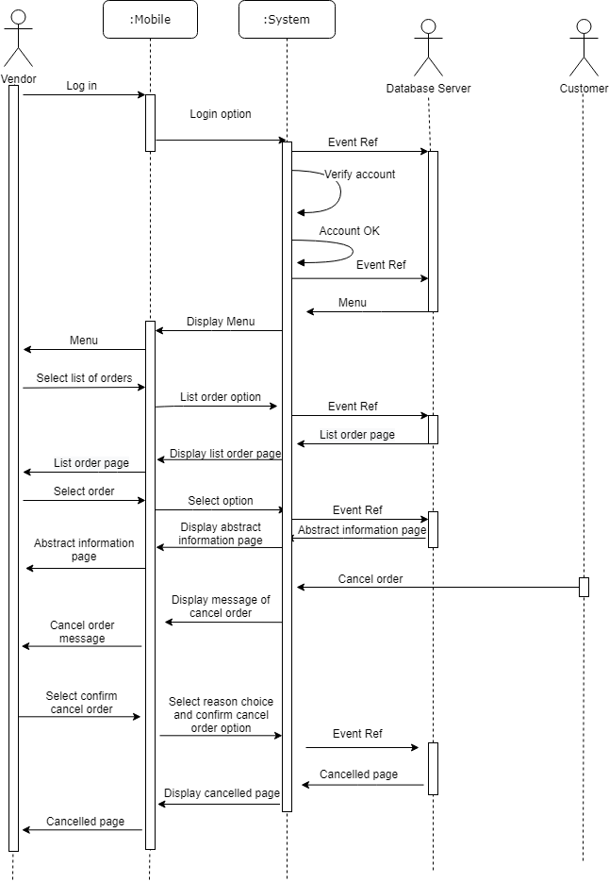
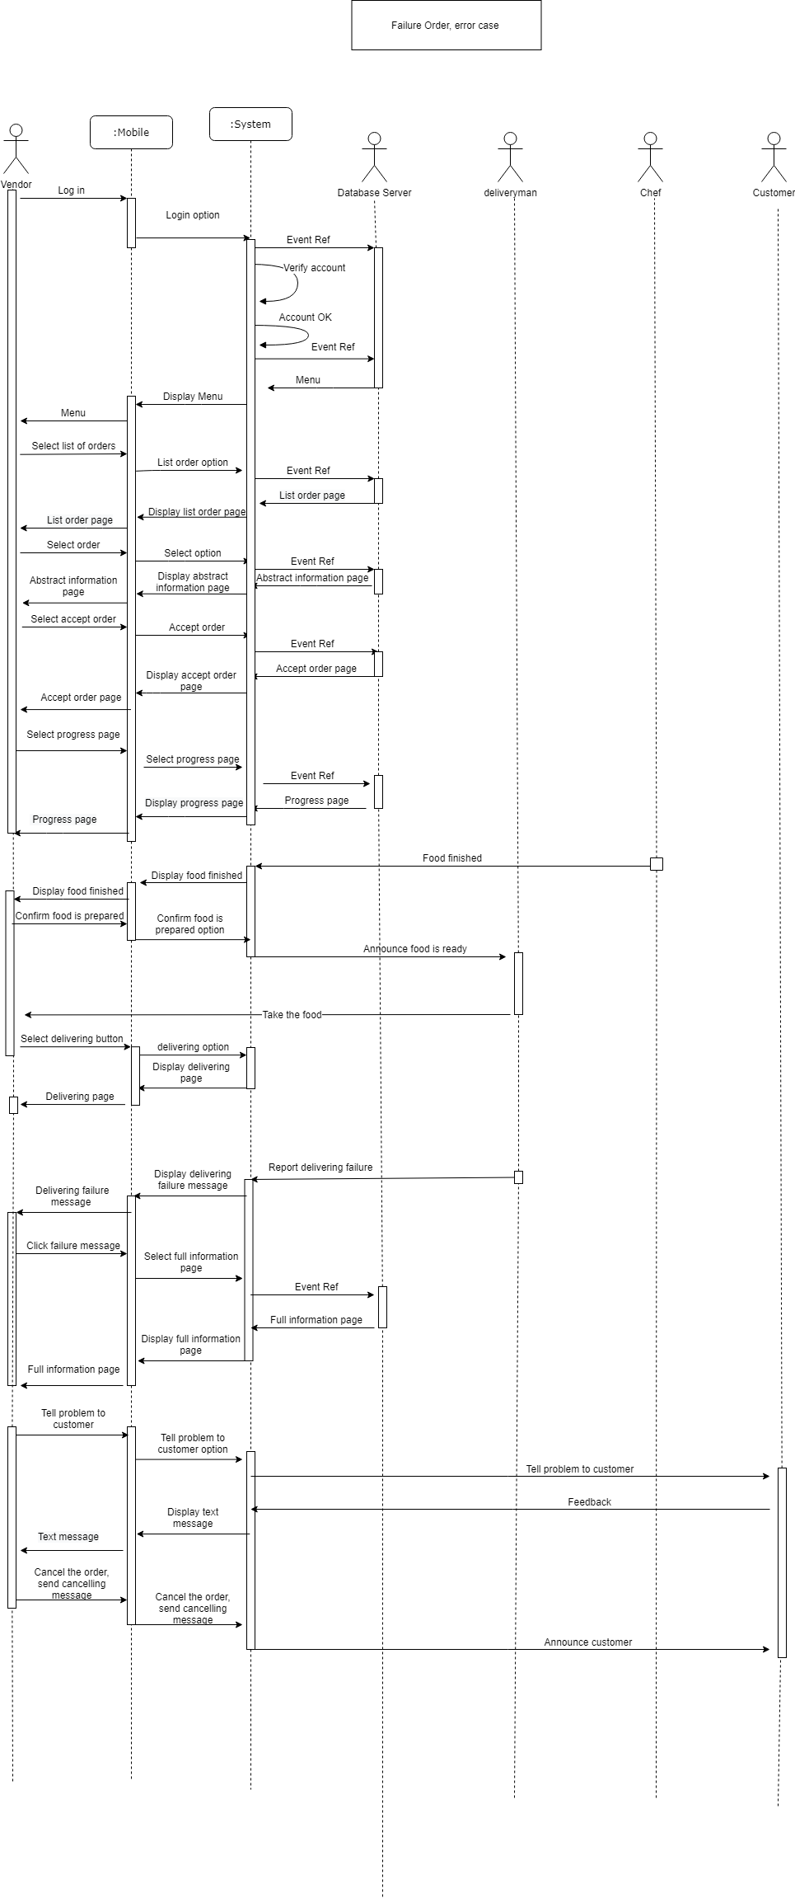
Design Model Sequence Diagrams-Exceptional scenario of accept order
Cancel order
Failure delivery order

Slide 20
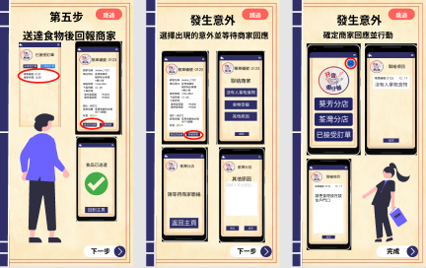
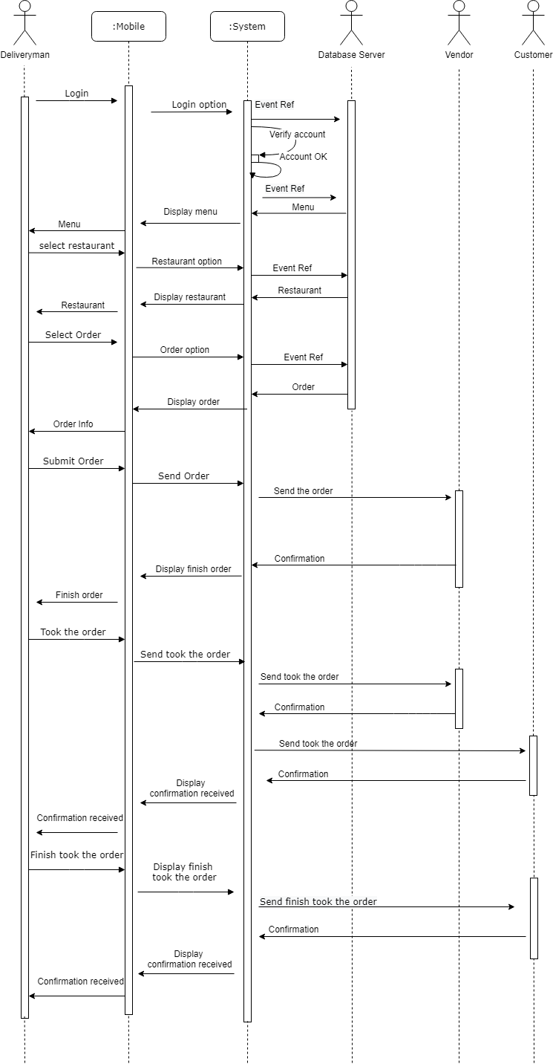


Design Model Sequence Diagrams-Normal and Exceptional scenario of ordering
Deliveryman has accident

Slide 21
Define the most appropriate software process model

Slide 22
Define the most appropriate software process model
Incremental development combines with reuse approach in implement is the most appropriate software process model.
It is the most effectivity way to build the software in short time compared to waterfall model as it needs a long time to build the system and write the document also is hard to change the customer requirements if the customers want to add some specific function.
Reuse approach can reduce total cost and time of software development as to build up a new software need a lot of money cost and time as need a lot of time to testing the software.
The risk factor is very low as the software is already working in the old system so that it will be more stable than a new system.

Slide 23


Moreover, “Online Food Ordering and Delivery Services” is very common nowadays there are a lot of free sources which we can use some of the components like the shopping cart or the coupon function in it in our system then we only need to add the new components to fulfill the requirements we added.
Of course, it is not acceptable that customer to add function as many as they want, so we decide to set a limit 4 times to let the customer add functions.

Slide 24
We are using agile development Extreme Programming (XP) which is the faster way to build up the system in short time, first we will break down the story into “Tasks” then programming it by pair developers work in pair to check each other's, also all the team’s developers can change the code in the system.
Then, once the task is done there will have a lot of tests in the system until all the system pass and there will have an on-site customer available in the team. At last, we will have a small release every month if customer need within one year.

Slide 25

Time management
Distribution of work
Identify the current problems or limitations: CHEUNG Chung Yin, NG Ka Wah
Objectives of the proposed system: NG Long Hin
Functional requirements: All
Non-functional requirements: TSANG Kit Hong Andrew , WAN Sheung Yam
Define the most appropriate software process model: NG Ka Wah
System Design Specification: All
Interface design
Customer: NG Ka Wah ,TSANG Kit Hong Andrew
Vendor: CHEUNG Chung Yin, NG Long Hin
Deliveryman: WAN Sheung Yam

